Slide 1


Financial Transaction Fraud Analysis
Predicting the Financial Fraud using machine learning
Presented By
Mr. XZY

Slide 2
Introduction
Content:
Objective: Use exploratory data analysis (EDA) to understand transaction patterns, identify how fraudulent transactions differ from normal activity, and establish a foundation for effective fraud detection.
Problem: Fraudulent transactions often resemble genuine ones, making them difficult to detect in real-world financial data, and manual checks are not feasible at scale..
Goal: Explore the data, find patterns linked to fraud, and then train models that can predict and flag suspicious transactions for future use.

Slide 3
Project Process
Data Sources:
We used the Financial Transaction Fraud Detection dataset from Kaggle.
It includes transaction details like time, amount, customer info, merchant category, device type, and whether the transaction was fraudulent.
Data Cleaning & Preprocessing:
We ensured timestamps were readable and categories well-labeled.
The data was cleaned and analyzed in Python for smooth use.
Data Visualization:
Used Matplotlib and Seaborn in Python to explore patterns.
Interactive dashboards were built in Power BI for deeper insights.

Slide 4
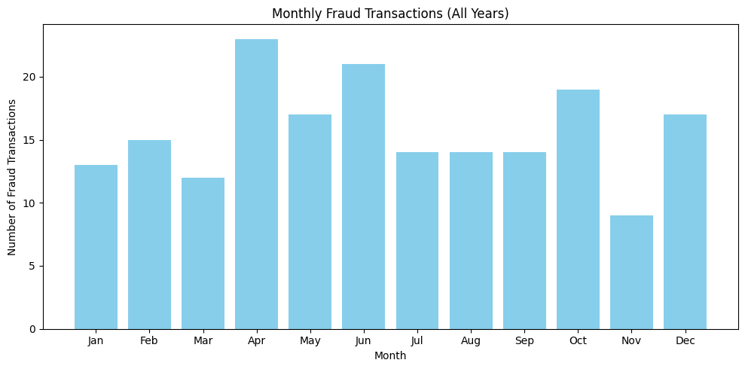
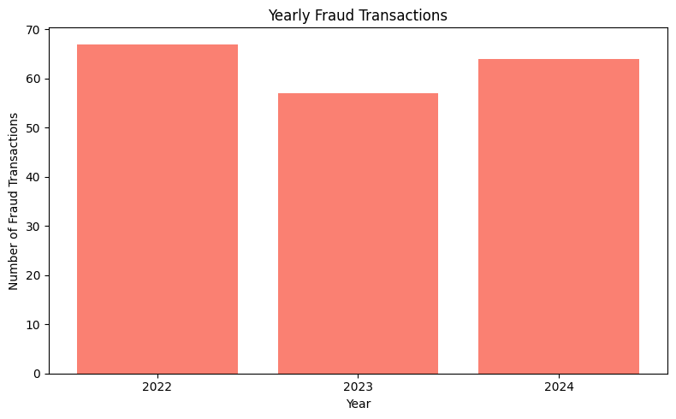
Monthly & Yearly Fraud Transactions
Fraud cases peaked in 2022, with the next highest in 2024.
By month, April had the most fraud cases, followed by June, October, and December.
November recorded the lowest fraud cases.
July, August, and September had fairly constant fraud activity.

Slide 5
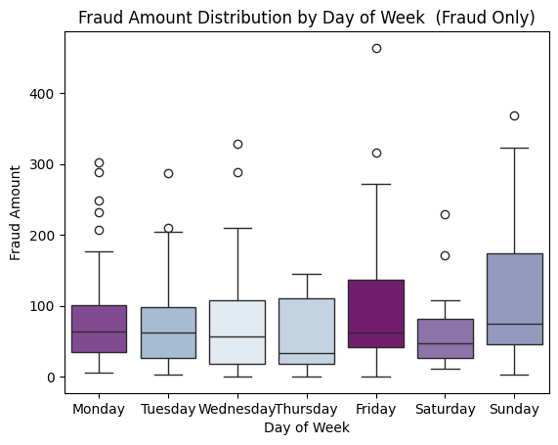
Weekly Fraud Transactions
The median fraud amount was highest on Fridays, indicating peak fraudulent activity.
Saturday had the lowest median and smallest interquartile range, reflecting minimal fraud.
Fraud cases generally decreased from Tuesday to Thursday.
Overall, fraud was more common on weekdays than weekends.

Slide 6
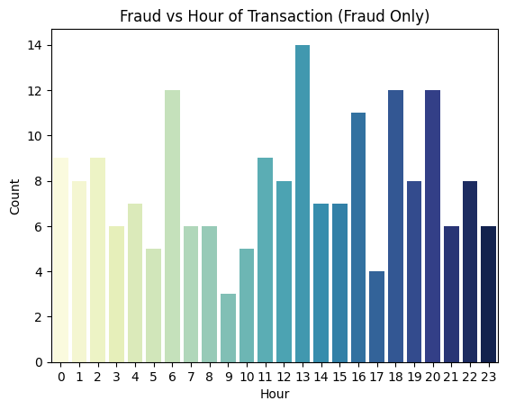
Hourly Fraud Transactions
Fraud peaked at 13:00 (1 PM), followed by spikes at 18:00 (6 PM), 20:00 (8 PM), and 06:00 (6 AM).
In general, fraud activity was higher between 9 AM – 3 PM and again during evening hours.
Lowest fraud occurred during midnight to 5 AM.
Apply stricter real-time monitoring during peak hours, especially 1 PM and evening periods.
Reallocate fraud investigation resources to cover high-risk periods.

Slide 7
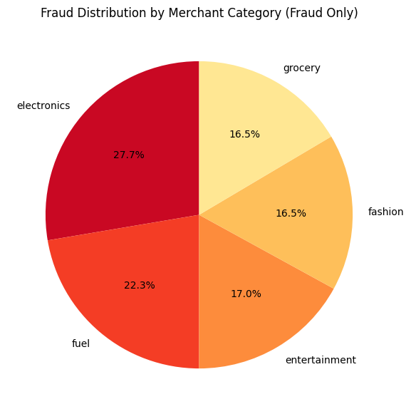
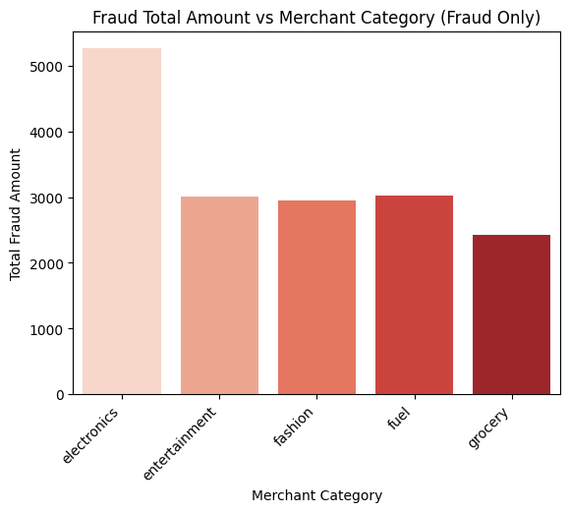
Fraud Transaction among Merchant Category
Fraud cases were highest in the Electronics category, accounting for the largest share of fraudulent transactions.
The Fuel category ranked second, while categories such as Fashion and Grocery showed comparatively lower fraud activity.
A total of $52,000 in fraudulent transactions was recorded in Electronics products alone.

Slide 8
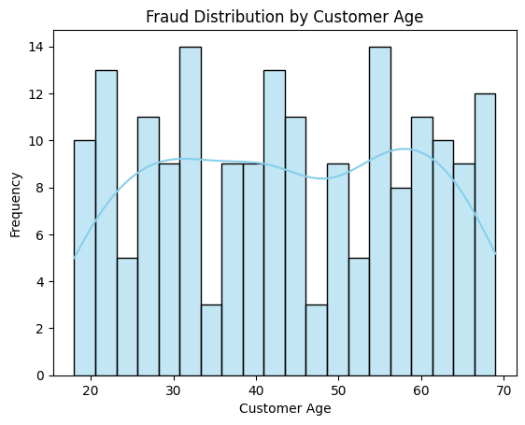
Fraud Transactions by Customer Age
Fraud incidents were observed across nearly all age groups, indicating a relatively widespread risk profile.
The concentration of fraudulent activity was noticeably higher among customers aged 52 to 68 years.
Outside this range, fraud cases were more sporadic and did not exhibit a strong clustering pattern.
Provide awareness campaigns tailored to customers aged 52–68, focusing on common fraud tactics.

Slide 9
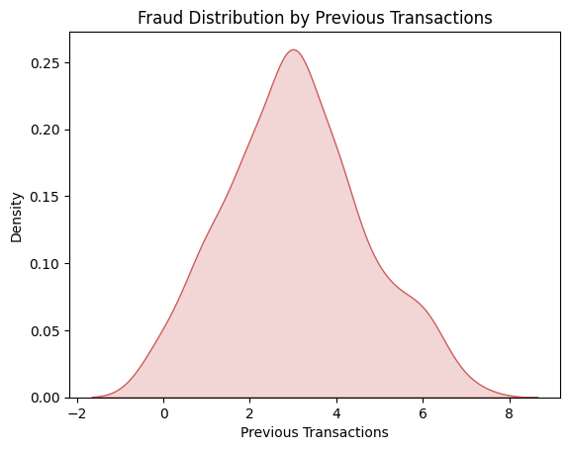
Fraud Transactions by Previous Transactions
Analysis of previous transaction history shows that customers with 3 prior transactions exhibited the highest incidence of fraud, indicating that fraudsters may target accounts with some activity but still relatively new.
Fraud risk does not increase linearly with transaction history, indicating that experience alone is not a reliable predictor of fraud.
Use behavioural analytics rather than relying solely on transaction count; flag anomalies even for experienced accounts.

Slide 10
Fraud Transactions by Customer Age
Fraud incidents were observed across nearly all age groups, indicating a relatively widespread risk profile.
The concentration of fraudulent activity was noticeably higher among customers aged 52 to 68 years.
Outside this range, fraud cases were more sporadic and did not exhibit a strong clustering pattern.
Provide awareness campaigns tailored to customers aged 52–68, focusing on common fraud tactics.

Slide 11
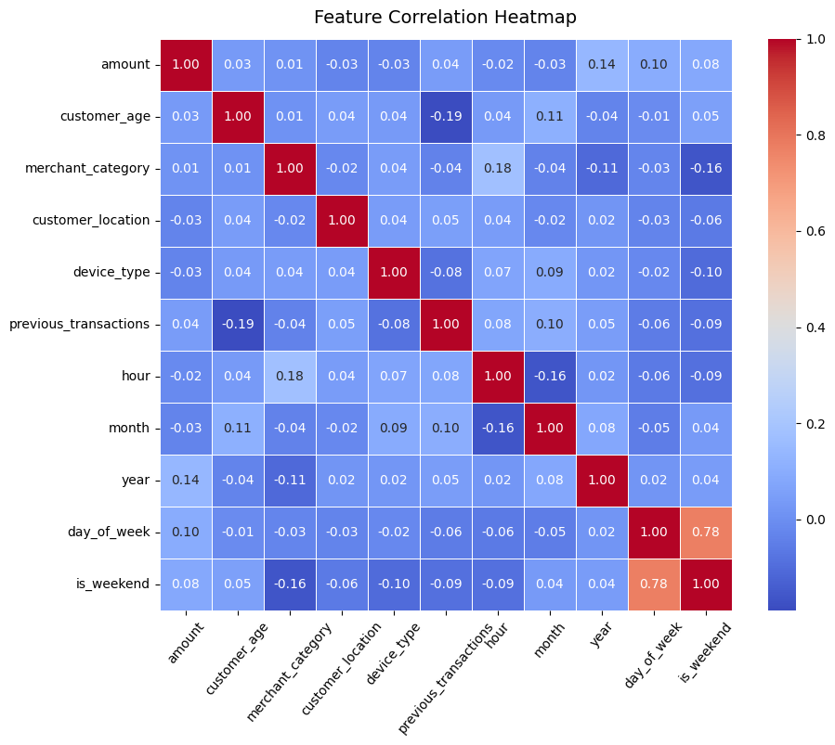
CORRELATION MATRIX HEATMAP
Weak correlations overall: Most features have very low correlation values, indicating that fraud is spread across different conditions and no single feature strongly predicts it.
Amount-related patterns: amount has slight positive correlations with year, day_of_week, and is_weekend, suggesting fraud amounts are slightly higher on certain days or in recent years.
Time and categorical features: hour, month, merchant_category, customer_location, and device_type all show minimal correlation with other features, meaning fraud occurs across various times, categories, and locations.
Expected strong link: day_of_week and is_weekend are strongly correlated (0.776) as weekends correspond to specific days, but other features remain largely independent.

Slide 12
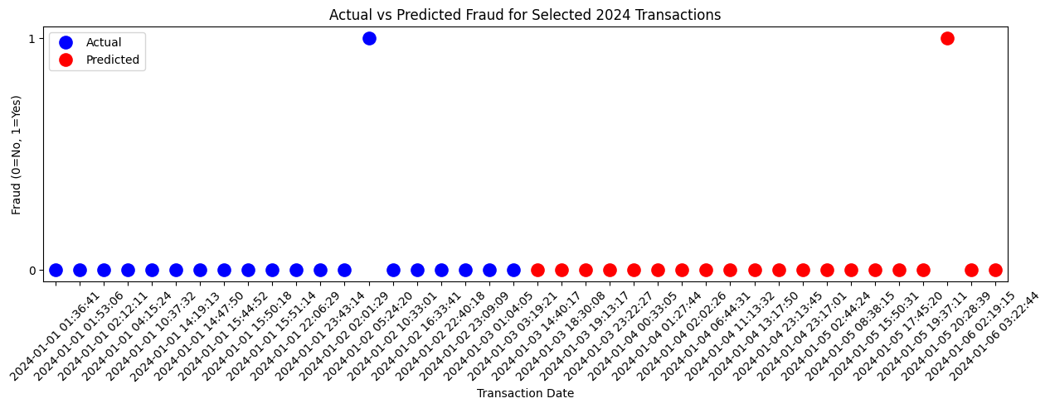
Fraud Transactions vs Predicted
Actual vs Predicted: Left 20 transactions show actual fraud (blue), right 20 show model predictions (red).
Y-axis: 0 = Non-Fraud, 1 = Fraud; most transactions are non-fraud.
Predictions: Few red points at 1 indicate the model flags limited transactions as fraud.
Date Pattern: X-axis shows transaction dates; any clustering of predicted frauds may indicate suspicious periods.

Slide 13
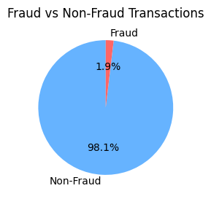
OVER ALL INSIGHTS
Overall Fraud
There were a total of 10,000 transactions, of which 188 transactions
(1.88%) were fraudulent.
Out of a total transaction amount of $977,499.72, about
$16,663.49 was fraudulent
The average fraud amount was $88.64.
Fraud by Merchant Category
Fraudulent transactions were most frequent in the electronics category, totalling $5,264.33, followed by fuel ($3,016.93), entertainment ($3,000.72), fashion ($2,951.08), and grocery ($2,430.43). Electronics clearly accounted for the largest portion of total fraud amount.
Customer Age Profile
Fraud occurred across a wide range of ages, from 18 to 69 years, with the average age of fraud victims being 43.7 years.
Fraud by Hour of Day
Fraud cases were observed throughout the day. Peak fraud occurred at 1 PM (14 cases), with other notable spikes at 6 AM, 6 PM, and 8 PM (12 cases each). The fewest fraud cases occurred around 9 AM (3 cases).

Slide 14
OVER ALL INSIGHTS
Fraud by Day of Week
Friday saw the highest number of fraud cases (35 cases, $3,245.60), followed by Tuesday (31 cases, $2,870.45), Monday (30 cases, $2,795.20), Sunday (32 cases, $2,998.10), Wednesday (24 cases, $2,150.75), Thursday (19 cases, $1,712.30), and Saturday (17 cases, $1,591.50). Overall, fraud was more common on weekdays (139 cases, $11,873.90) than weekends (49 cases, $4,589.10).
Fraud by Device Type
Fraud was most frequently conducted via tablets (71 cases, $6,120.50), followed by desktops (60 cases, $5,210.30) and mobile devices (57 cases, $5,332.69).
Fraud by Previous Transactions
Customers with 3 previous transactions exhibited the highest fraud occurrence (54 cases). Customers with 2 or 4 previous transactions also showed notable fraud (35 cases each), while those with 0 or 7 previous transactions had the fewest fraud cases.

Slide 15
RECOMMENDATIONS
Deploy real-time monitoring for suspicious transactions and focus on high-risk categories like
electronics and fuel; update fraud detection rules regularly.
Extra verification for customers aged 43–68 and close monitoring of repeat customers with 2–4 prior transactions.
Stricter monitoring and amount thresholds for electronics/fuel merchants; dynamic alerts for unusually high transactions; encourage multi-factor authentication.
Heightened scrutiny during 9 AM–3 PM and 6–8 PM; extra verification on Fridays; batch-check low-risk hours (midnight–5 AM).
Use device fingerprinting and two-factor authentication for tablets/mobiles; monitor IP/geolocation anomalies; encourage device and app updates.

Slide 16
RECOMMENDATIONS
Use ML models with features like amount, merchant, hour, device, and previous transactions; retrain regularly and visualize trends via dashboards.
Apply transaction limits and velocity checks for high-risk customers or categories; train staff and merchants on fraud awareness; notify customers for unusual transactions; conduct post-mortem audits.
Assign risk scores per transaction; implement anomaly detection for emerging patterns; create feedback loops with confirmed fraud cases; use fraud heatmaps for time, location, and device type.
Key takeaways: Fraud is concentrated in electronics/fuel, certain age groups, and specific hours/days; device type and previous transactions are strong indicators; combining ML, real-time monitoring, and policy interventions yields highest impact; continuous data-driven evaluation ensures adaptive fraud prevention.

Slide 17
THANK YOU
Financial Transaction Fraud Analysis
Predicting the Financial Fraud using machine learning
Presented By
Mr. XZY

